Slide 1
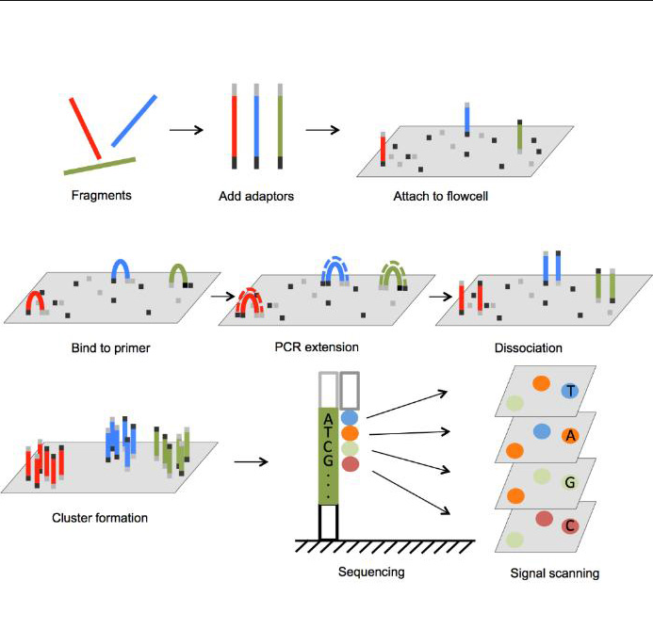
Sequencing technologes: Illumina
Overview of Illumina Sequencing by Synthesis Workflow | Standard SBS chemistry
Potential problems with Illumina data:
Incomplete incorporation, leads to “de-synchronization” of spots, quality decreases along the read
Reverse read spots are bigger -- lower intensity, higher error rate
Errors:
Sequencing is discrete process most of the errors are substitutions, indels are rare (1/100)
Typical error rate of 1%
High coverage: two or more reads can have the same error at the same base
Souurces: https://www.bmkgene.com/dnarna-sequencing-illumina-sequencer-product/, Illumina

Slide 2
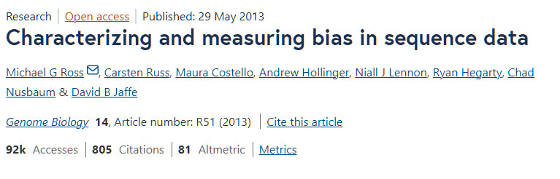
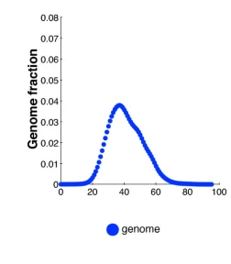
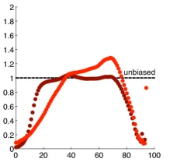

Sequencing: GC bias
Illumina: there are biases due to flexibility of strands (GC bias)

Slide 3
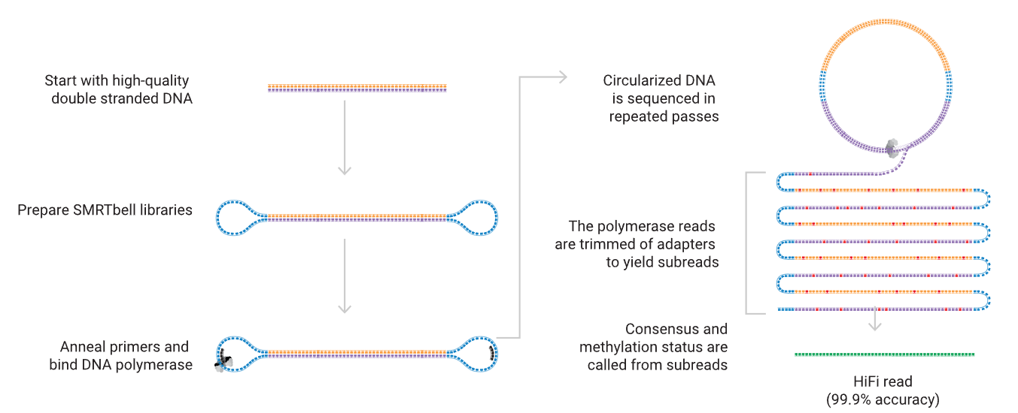
Sequencing technologies: PacBio CLR/HiFi
Sequencing 101: from DNA to discovery — the steps of SMRT sequencing - PacBio
Source: PacBio

Slide 4
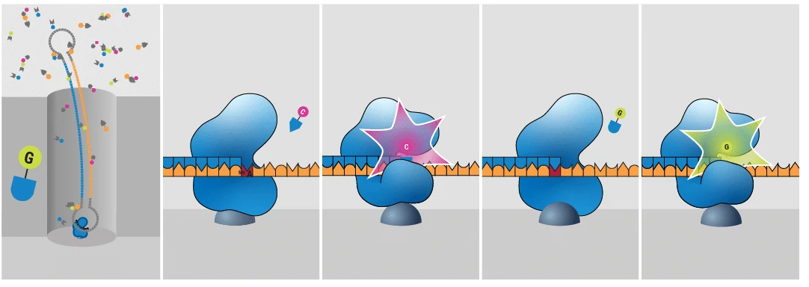
Sequencing technologies: PacBio CLR/HiFi
Sequencing 101: from DNA to discovery — the steps of SMRT sequencing - PacBio
Source: PacBio

Slide 5
Sequencing technologies: PacBio CLR/HiFi
Sequencing 101: from DNA to discovery — the steps of SMRT sequencing - PacBio
Source: PacBio

Slide 6
Sequencing technologies: PacBio CLR/HiFi
Potential problems with PacBio data:
CLR reads are longer but have ~15% error rate
Most errors are insertions (~10% of the 15%)
Polymerase pauses -- insertions of random sequence
Chimeric “palindrome” reads -- no SMRTbell adapter
Errors:
Most errors in CLR are insertions (~10% of the 15%)
HiFi reads have variable (~1%) error rate, longer reads=higher error rate
Some reads have higher error rate
Sequencing 101: from DNA to discovery — the steps of SMRT sequencing - PacBio
Source: PacBio

Slide 7
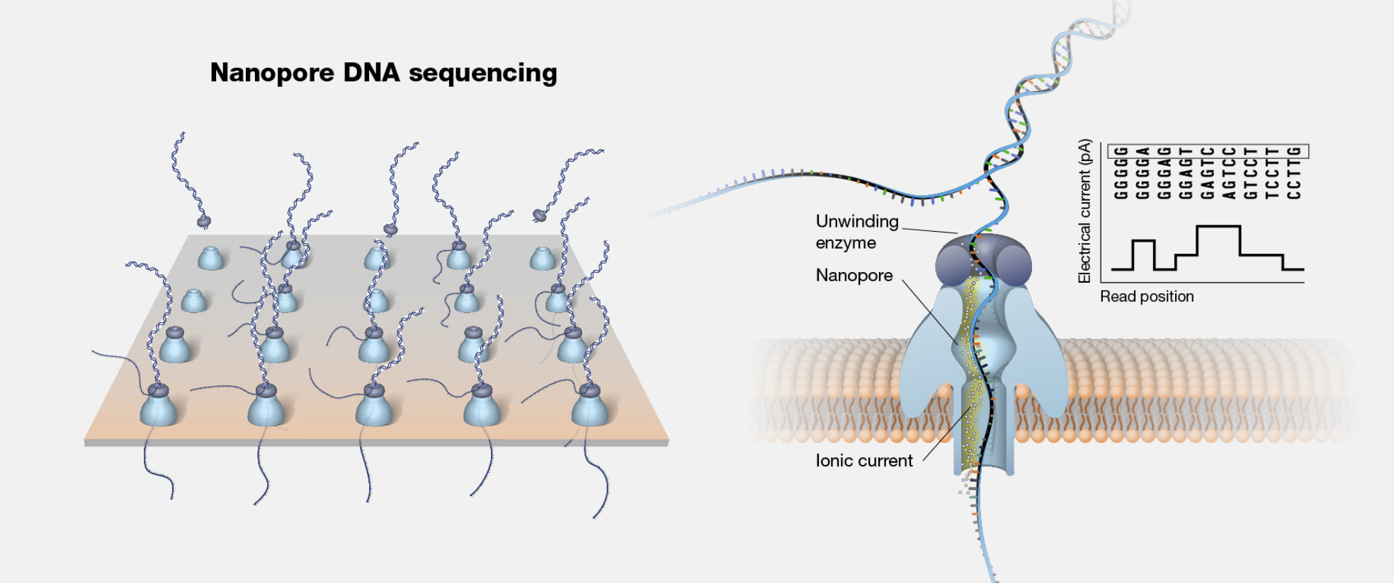
Sequencing technologies: Oxford Nanopore
How nanopore sequencing works | Oxford Nanopore Technologies
Source:genome.gov

Slide 8
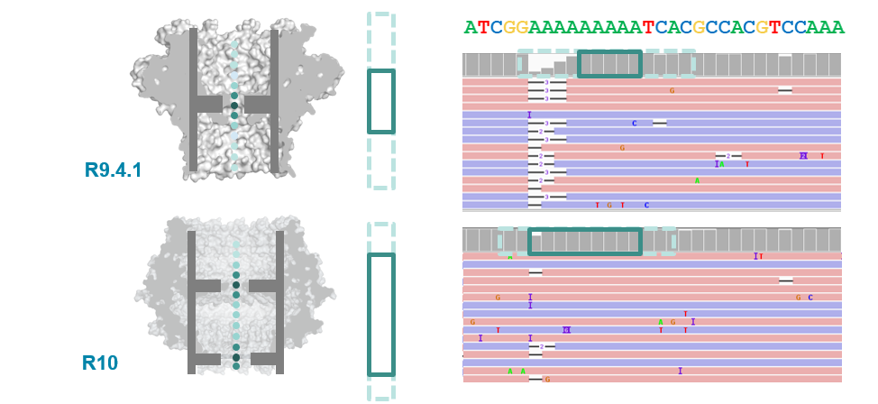
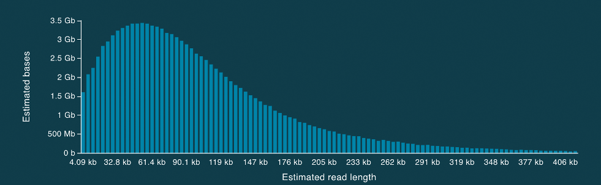
Sequencing technologies: Oxford Nanopore
Oxford Nanopore:
higher error rates (5-7%), lower for R10 (2 currents)
Unable to estimate speed -- errors in homopolymers (AAAAAAA), SSRs (ATATATA)
difficulties with getting long reads, some species (crustaceans/coffee) are hard to sequence (low yield)
chimeric reads due to fragments of DNA sticking together

Slide 9
Dealing with errors in the reads
You can compensate for some of the errors
Create a dictionary of all (K-mer -> count) pairs in all reads
K-mer counts
At 100x genome coverage most (but not all) K-mers of count 1 contain errors
Can correct of filter out reads with locally low K-mer counts

Slide 10
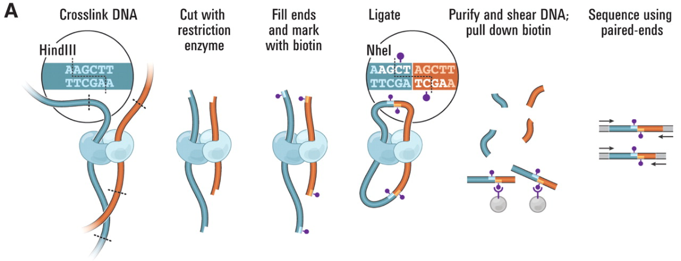
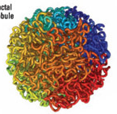
Types of sequencing reads
Proximity ligation or Hi-C libraries
Sequenced with paired-end Illumina
Images from: Van Berkum NL, Lieberman-Aiden E, Williams L, Imakaev M, Gnirke A, Mirny LA, Dekker J, Lander ES. Hi-C: a method to study the three-dimensional architecture of genomes. Journal of visualized experiments: JoVE. 2010(39).

Slide 11
Types of sequencing reads
Proximity ligation or Hi-C libraries
Sequenced with paired-end Illumina
Images from: Van Berkum NL, Lieberman-Aiden E, Williams L, Imakaev M, Gnirke A, Mirny LA, Dekker J, Lander ES. Hi-C: a method to study the three-dimensional architecture of genomes. Journal of visualized experiments: JoVE. 2010(39).

Slide 12
Types of sequencing reads
Proximity ligation or Hi-C libraries
Sequenced with paired-end Illumina
Images from: Van Berkum NL, Lieberman-Aiden E, Williams L, Imakaev M, Gnirke A, Mirny LA, Dekker J, Lander ES. Hi-C: a method to study the three-dimensional architecture of genomes. Journal of visualized experiments: JoVE. 2010(39).

Slide 13
Types of sequencing reads
Proximity ligation or Hi-C libraries
Sequenced with paired-end Illumina
Images from: Van Berkum NL, Lieberman-Aiden E, Williams L, Imakaev M, Gnirke A, Mirny LA, Dekker J, Lander ES. Hi-C: a method to study the three-dimensional architecture of genomes. Journal of visualized experiments: JoVE. 2010(39).

Slide 14
Types of sequencing reads
Proximity ligation or Hi-C libraries
Sequenced with paired-end Illumina
Images from: Van Berkum NL, Lieberman-Aiden E, Williams L, Imakaev M, Gnirke A, Mirny LA, Dekker J, Lander ES. Hi-C: a method to study the three-dimensional architecture of genomes. Journal of visualized experiments: JoVE. 2010(39).

Slide 15
Types of sequencing reads
Proximity ligation or Hi-C libraries (variants: Omni-C, Chicago)
Sequenced with paired-end Illumina
Images from: Van Berkum NL, Lieberman-Aiden E, Williams L, Imakaev M, Gnirke A, Mirny LA, Dekker J, Lander ES. Hi-C: a method to study the three-dimensional architecture of genomes. Journal of visualized experiments: JoVE. 2010(39).

